Slide 1

Basic or Luxury Paris
Matthew Carrico

Slide 2
About the Data
Dataset was found on Kaggle.com
10000 rows and 18 columns

Slide 3

Why I Chose This Data
It looked interesting
Had the right amount of variables

Slide 4
About the Model
The Logistic Regression model was used to predict if a property was Luxury or Basic using the model accuracy calculation

Slide 5
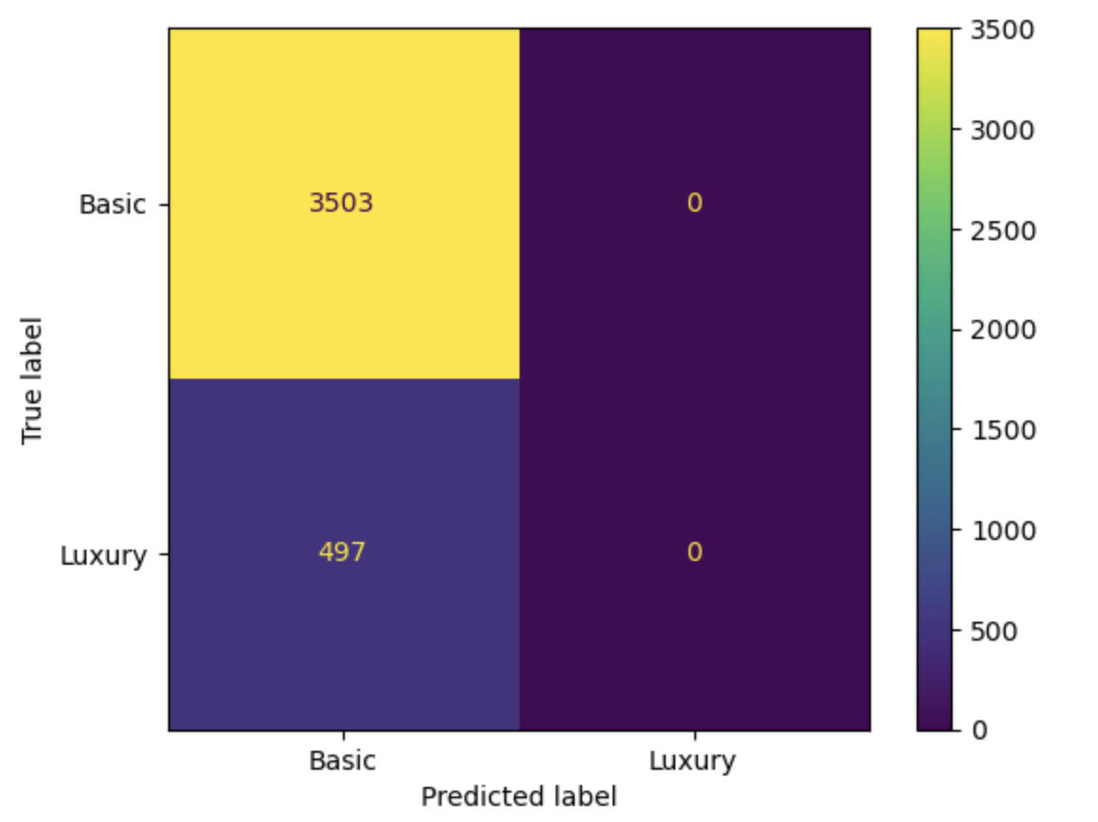
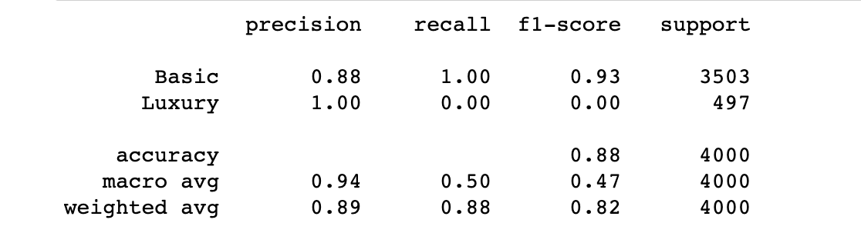
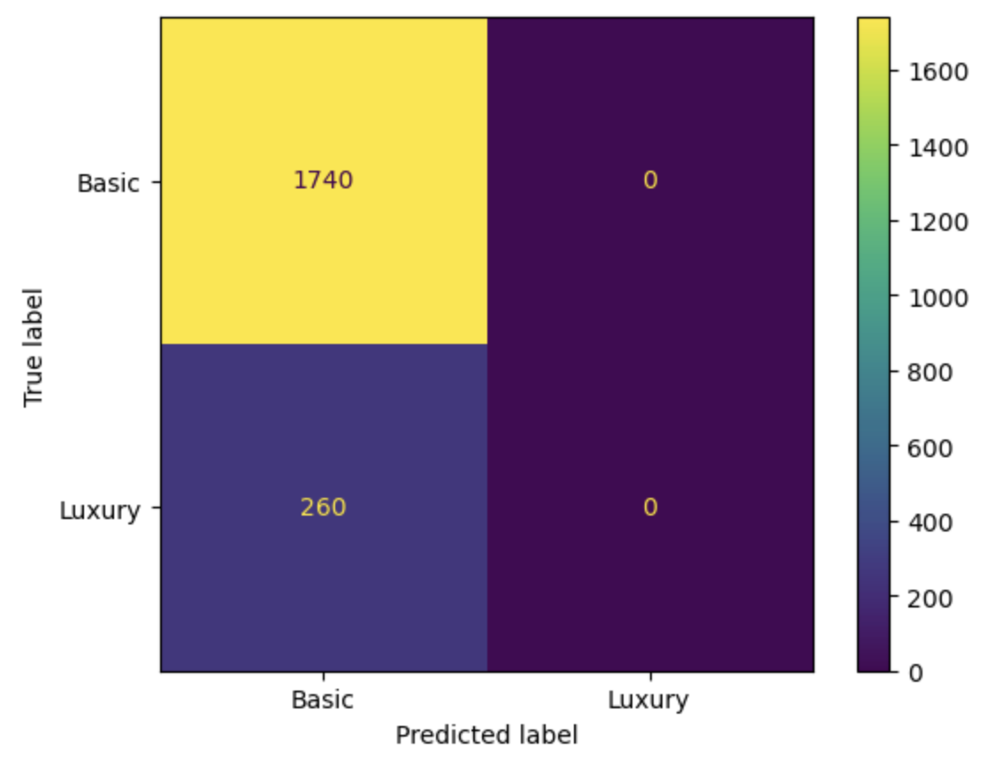
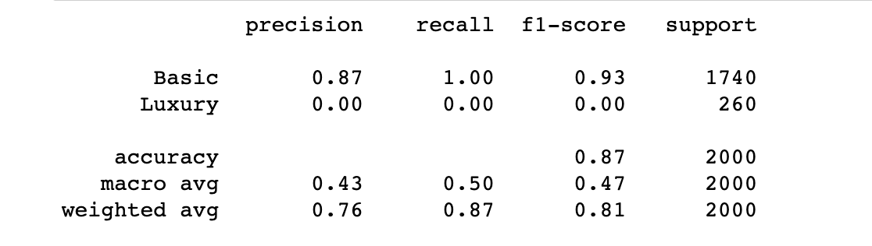
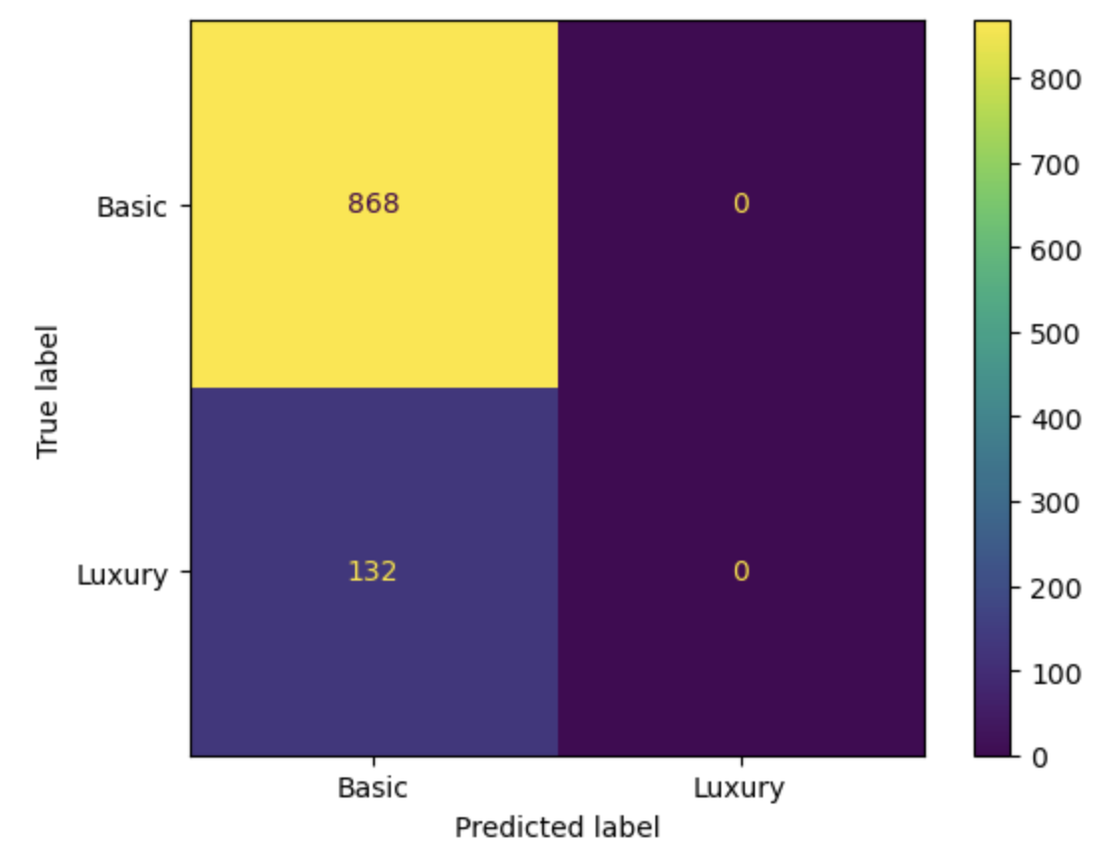
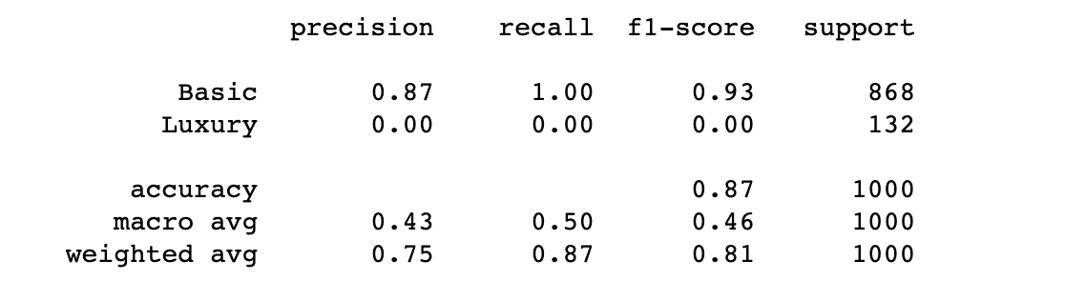
Results

Slide 6
Conclusion
Experiment 1 was the most accurate at 88% with a 60/40 spilt using a state size of 50.
Potential of the data set using other models.

